Slide 1
Cache Replacement

Slide 2
LLC Replacement Final level before data requests move to access Memory
L1
Least Recently Used
This is the most commonly used algorithm for LLC replacement
Glider, Hawkeye, SHiP, SRRIP
State of the art LLC replacement policies
L2 Cache
L3 or Last Level Cache
Memory
Notes:
The Last-Level Cache (LLC) is a critical component of the memory hierarchy which has a direct impact on performance. Whenever a data requested by a processor core is not found in the cache a transaction to the main memory is initiated, which results in both performance and energy penalties. Decreasing LLC miss rate therefore lowers external memory transactions which is beneficial both power and performance wise. The cache replacement policy has a direct impact on the miss rate. It is responsible of data eviction of cache lines whenever the cache runs full. Thus, a good policy should evict data that is less likely to be reused in the near future, and favor data that are likely to be accessed.

Slide 3
Perceptron Using a single Layer Neural Network to Predict Reuse
6 Input Features
PC History and Tag used as input features
6 Perceptron Tables
With 256 entries in range [-32, +32]. These are indexed by each feature.
PC₀ >> 2
PC₁ >> 1
PC₂ >> 2
y_{out}
PC₃ >> 3
Result
Weights added to get the perceptron output.
This is compared against thresholds for reuse computation and training
Tag >> 4
Tag >> 7
Notes:
Talk about the working of perceptron.

Slide 4
Training - Sampler Additional SRAM used to store samples for perceptron training
64 Sets of 16 Way Set Associative Memory
Every 32th (Blocks/sets in sampler) set is sampled to this memory.
On a hit in the sampler, we train the perceptron to decrement its weights if y_{out} > -θ
On a miss, we find an entry to evict by
Fist looking for an invalid block
Second, a dead block where y_{out} > τ_{replace}, or
Last, using LRU
Train the perceptron to increment its weights if y_{out} < -θ
The sampler entry is updated with the new set of features and perceptron output (for both hit and miss)
Tag (15 bits) | Y_{out} | Input Features | LRU bits
Notes:
Talk about the working of perceptron.

Slide 5
Perceptron - Eviction Using the perceptron results to predict blocks less likely to be reused
Cache Line
Thresholds
θ | 74
τ_{replace} | 124
τ_{bypass} | 3
reuse bit
Reuse Bit
1 bit flag added to each cache line to indicate if it would be reused or not
This is set on each LLC access y_{out} < τ_{replace}, else it is set to false
Finding a victim
Consult the perceptron to get y_{out} for incoming address.
If the value is higher that the threshold τ_{bypass}, it bypasses the LLC.
In every other case, we check for a dead block in the set – a block with reuse bit set to 0.
If that is also not found, evict the least recently used block
Notes:
Talk about the working of perceptron.

Slide 6
Simulation Results Comparing the perceptron implementation to LRU
The algorithm was created using Champsim and was trained on a single core CPU with 2MB 16-way LLC and was tested on the SPEC 2017 suite if benchmarks
Notes:
Bypass was disabled for the sake of simulation as champsim kept going in to dead lock state when this was enabled.

Slide 7
The algorithm was created using Champsim and was trained on a single core CPU with 2MB 16-way LLC and was tested on the SPEC 2017 suite if benchmarks
Notes:
Bypass was disabled for the sake of simulation as champsim kept going in to dead lock state when this was enabled.

Slide 8

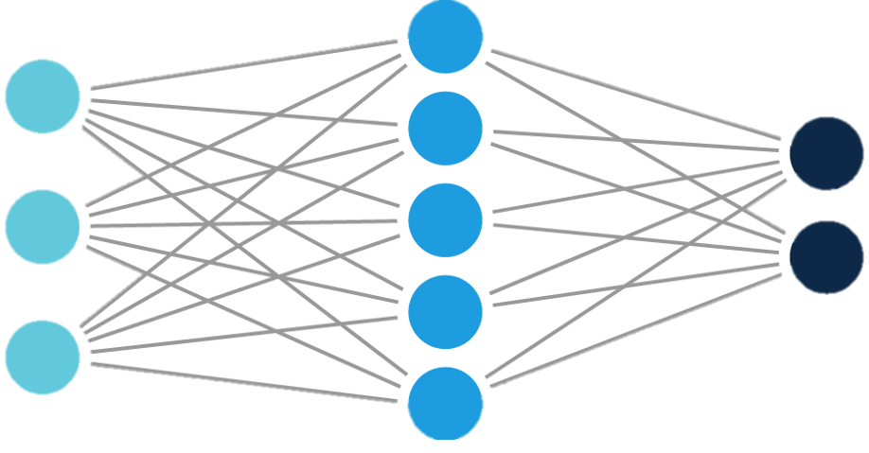
Reinforcement Learning Replacement Offline RL based model to train a network to predict reuse of blocks
SPEC2017 Traces
Trace files are fed into a modified version of Champsim to create LLC access traces.
<IP, address, type>
Champsim
Models the cache state and computes all the parameters required for the input vector.
This reads the clear text trace from Champsim
Cache State Model in Python
Reward
Based on distance from optimal replacement
Input State
A vector of 214 entries with cache access information, set details and cache line level details (for the current set). This gives a relevant parts of the overall cache for the current request.
Output
A 16 (number of ways) long vector giving a value to each action to be taken (which line to replace).
Q Value Network
Notes:
Talk about the working of perceptron.

